Slide 1

Ally Rx Dual Eligible Special Needs Plan Introduction (2024)

Slide 2


Slide 3


Objectives:
What is a Dual-Eligible Special Needs Plan (D-SNP)?
What is the purpose of our Ally Rx D-SNP?
Ally Rx Model of Care (MOC)
Ally Rx Member Benefits
Ally Rx Member support & care coordination

Slide 4
What is a D-SNP?
A Dual Eligible Special Needs Plan (D-SNP) is a special type of Medicare Advantage Prescription Drug Plan that provides benefits to members who are eligible for both Medicare and full-benefit Medicaid.
    Designed to provide targeted care to the member
    Medicare is always primary
    Medicaid is the payer of last resort and supplements Medicare coverage
Medicare
Medicaid
D-SNP

Slide 5
Who are dual eligible members?
Individuals who:
    Meet State income and asset criteria for the State’s Medicare Savings Program
    Are eligible for or enrolled in Medicare Part A and/or Medicare Part B
    Are enrolled in full-benefit Medicaid coverage
    Reside in the service area and receive care from network providers
    Have chronic or disabling health conditions
and/or the Medicare Savings Program

Slide 6
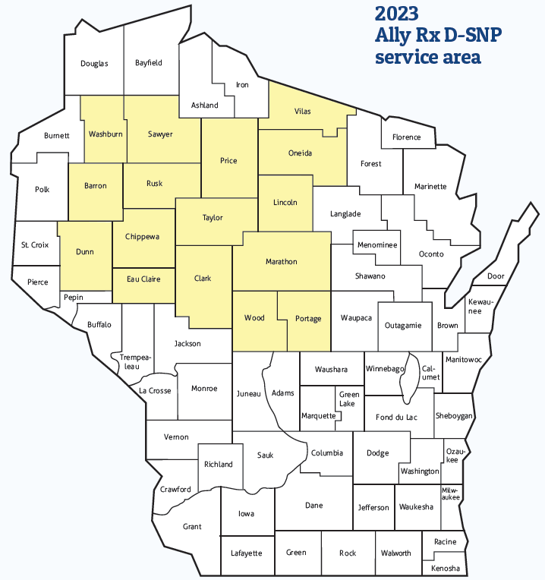
What is the service area?
Ally Rx D-SNP is offered in the following counties:
Barron
Chippewa
Clark
Dunn
Eau Claire
Lincoln
Marathon
Oneida
Portage
Price
Rusk
Sawyer
Taylor
Vilas
Washburn
Wood

Slide 7
What is the purpose of Ally Rx D-SNP?
Security Health Plan’s Ally Rx D-SNP program is specifically designed to:
  Integrate team-based care management model with a personal touch
  Offer personalized guidance by a care management team
    Registered Nurse
    Community Support Specialist
    Social Worker
    Health Services Coordinator
  Provide targeted care coordination to meet the special needs of these individuals
    Supported by: Pharmacists, Medical Director, Behavioral Health, Utilization Management, Wellness and other Security Health Plan clinical programs and services
  Provide resources to help members obtain the right care, at the right place, at the right time
  Serve a diverse population with complex medical, psychosocial, cognitive and socio-economic needs

Slide 8
Member Centric Care and Coordination
Every Ally Rx D-SNP member is supported by a dedicated care management team to provide personalized member centric care and coordination:
      Comprehensive initial and annual health assessment
      Individualized and personalized care plan
      Transition care if discharged from a hospital, skilled nursing facility and or a change in living environment
      Assistance with accessing community resources and support
      Coordination of Medicare and Medicaid benefits, services and providers
      Help navigating the health care system

Slide 9
Ally Rx D-SNP Model of Care (MOC)
D-SNPs must have a Model of Care (MOC). Our Ally Rx MOC:
      Provides a framework for how Security Health will meet the needs of its members.
      Details how Security Health will promote quality, care management, and care coordination processes.
      Reviewed & approved by the Centers for Medicare and Medicaid Services (CMS)
The MOC includes:
        Identifying the D-SNP population
        Care Management process and practices
        Provider Network – provider and network availability for D-SNP members
        Quality Improvement measures

Slide 10
Ally Rx D-SNP Model of Care (MOC)
The MOC includes:
      Identifying the D-SNP population
      Care Management process and practices
      Provider Network – provider and network availability for D-SNP members
      Quality Improvement measures

Slide 11

Improving Healthcare Outcomes
Care coordination assists with improving healthcare outcomes, such as:
  Decreased hospitalizations
  Decreased emergency room visits
  Managing chronic diseases
  Improving access to quality healthcare services and benefits

Slide 12
What are the Ally Rx D-SNP member benefits?
Ally Rx D-SNP Services covered:
  Includes all benefits covered under Original Medicare.
Supplemental benefits include:
  Preventive dental
  SilverSneakers (fitness membership)
  Over the counter (OTC) products
  Eyeglasses stipend
Support by our Interdisciplinary Care Team (ICT)
  Assist each member in receiving the most appropriate, highest quality of care
  Creation of an Individualized Care Plan (ICP) based on the results of the member’s comprehensive Health Risk Assessment (HRA)

Slide 13
Who is the Ally Rx D-SNP Interdisciplinary Care Team (ICT) Team?
The dedicated ICT team:
  Participants in the team is based on member needs (Registered Nurse/RN, Social Worker, Community Support Specialist, Primary Care Provider/PCP, Medical Director, Pharmacist, Member Advocate, Wellness, member, family, caregivers)
  Ally Rx D-SNP care managers keep the team updated with information involving the member’s care plan and changes
  Team meets formally
  Each Ally Rx D-SNP member is managed by an ICT care team
  Assists to manage care and services for the Ally Rx D-SNP member to:
    avoid fragmentation
    ensure access to appropriate and person-centered care
    provide a team approach to address clinical, social and behavioral needs
Notes:
Added this page

Slide 14

What does the Ally Rx D-SNP ICT team do?
The ICT team, Community Support Specialist (CSS), Registered Nurse (RN), and Social Worker (SW), will work with the member to assure that they have access to the following services as needed:
Range of Choices
  Assist in ensuring access to an adequate range of choices for members by helping the member identify formal as well as informal support and services
  Help ensure the services are culturally appropriate as well as accessible in the rural areas of Wisconsin. Interpreter services are available for all Ally Rx D-SNP enrollees.

Slide 15


What does the Ally Rx D-SNP ICT team do? (Cont.)
Coordination with the Primary Care Provider and Specialists
  Assists the member in choosing a primary care provider
  Works with the member and primary care provider in accessing the appropriate specialty care
  Facilitates periodic preventive care
  Alerts the primary care provider to changes in health status or concerns as appropriate
  Facilitates communication and collaboration between primary care, specialists and mental health/substance abuse providers in support of a comprehensive and unified individual care plan

Slide 16
What does the Ally Rx D-SNP ICT team do? (Cont.)
    Assessment for Understanding of Treatment Plan and Medications
      Assess the members ability to understand their medications and ability to follow their prescribed plan
      Complete Medication Therapy Management (MTM) review upon enrollment; ongoing review as needed
      Assess the barriers and facilitate communication with the member’s physician and other providers as needed
    Identification of Special Needs and Referrals to Specialists
      Assists the member in obtaining necessary services to meet their individual needs
      Helps the member identify medical issues and functional problems such as:
        Poly-pharmacy issues
        Lack of social supports
        High risk health conditions

Slide 17
What does the Ally Rx D-SNP ICT team do? (Cont.)
    Coordination with Social Service Needs
      Collaborates with:
        Aging and Disability Resource Centers (ADRC)
        Long-term care programs including family care organizations and IRIS (Include, Respect, I Self-Direct)
        County agencies
    Coordination with Other Care Managers
      Communicates with other case management programs
        Behavior Health care managers
        Wellness coaches

Slide 18
What does the Ally Rx D-SNP ICT team do? (Cont.)
    Coordination of Transition between Care Settings
      Assessing member needs when moving from one care setting to another
        Hospitalizations
        Skilled nursing facility (SNF)
        Assisted living
        Other situations as identified

Slide 19
Care Coordination process with the Ally Rx D-SNP member
Enroll in Ally RX
Member Outreach
Health Risk Assessment
Care Team meeting
Create Care Plan
Ongoing Member Follow-up
Update Care Plan
Annual Health Assessment and Review
Three attempts contacting member, family, and/or Power of Attorney (POA)
Ongoing collaboration with community resources; including Transition Care Needs
Created within 60 days of enrollment.
Sent to Member & Provider.
Initial Comprehensive assessment completed within 90 days of enrollment
Provider feedback and communication

Slide 20
Care Coordination process with the Ally Rx D-SNP member (Cont.)
Members can refuse visits, calls and follow up by the Ally Rx D-SNP team.
  Per CMS requirements we continue to outreach routinely and with any transition identified.
  A refusal care plan is sent to the member if this takes place.
Members are at times hard to reach.
  The Ally Rx D-SNP team has a process in place for outreach attempts and follow up.
  An unable to reach care plan is sent to the member if this takes place.
Members have an annual face-to-face encounter.
  The encounter will be either in-person or through a visual, real-time, interactive telehealth encounter.
  The face-to face encounter is part of the overall care and follow up of the member.

Slide 21
Contact the Ally Rx D-SNP Team
Ally Rx D-SNP Shared email: shp.dsnp@securityhealth.org
Ally Rx D-SNP Shared Phone Line: 715-221-9560
Training Requirement:
  Centers for Medicare and Medicaid Services (CMS) require annual training for SHP staff working with Ally Rx D-SNP program or D-SNP members.

Slide 22

Thank you!

